Slide 1
LUNG CANCER DETECTION USING DEEP CNN PROJECT REPORT
Developed by:
B.Balamurali
R.Elavarasan
M.Elavarasan
M.Dineshwaran

Slide 2
Abstract:
Lung cancer is one of the most killer diseases in the developing countries and the detection of the cancer at the early stage is a challenge. Analysis and cure of lung malignancy have been one of the greatest difficulties faced by humans over the most recent couple of decades. Early identification of tumor would facilitate in sparing a huge number of lives over the globe consistently. This paper presents an approach which utilizes a Convolutional Neural Network (CNN) to classify the tumors found in lung as malignant or benign.

Slide 3
1.INTRODUCTION:
Lung cancer is of disease of abnormal cells multiplying and growing into a tumor. Cancer cells can be carried away from the lungs in blood, or lymph fluid that surrounds lung tissue. Lymph flows through lymphatic vessels, which drain into lymph nodes located in the lungs and in the center of the chest. Lung cancer often spreads toward the center of the chest because the natural flow of lymph out of the lung is towards the center of the chest.

Slide 4
Basic Process:
Data Collection
01
The Lungs dataset is created by our team members.
Data Preprocessing
02
Subtracted the local average colour average to 50% grey.
Model Training
03
CNN algorithm is used for training.
Flask
04
To Deploy and we create User Interface.

Slide 5
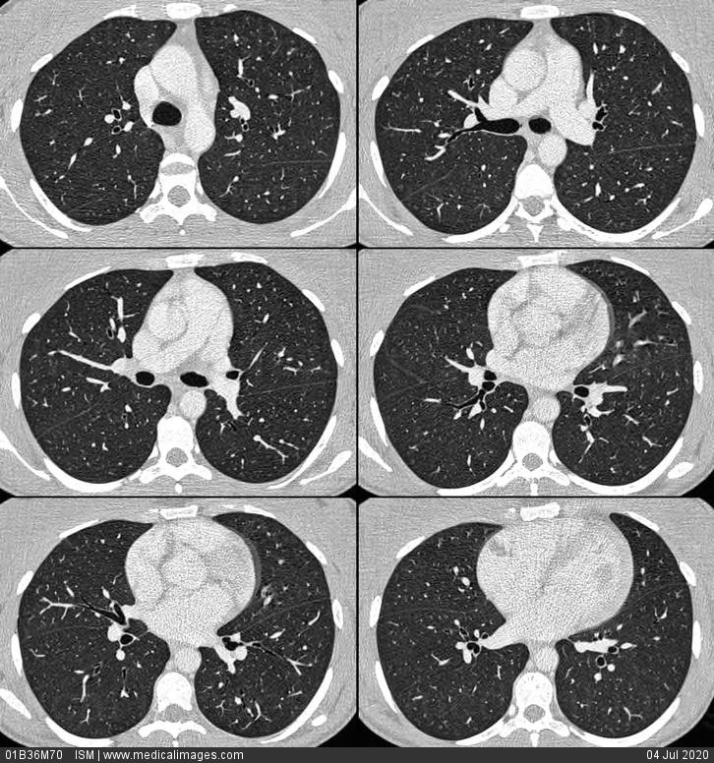
Data Collection:
The Lungs dataset is created by our team members.
Dataset has size 22Mb

Slide 6
Data preprocessing:
In preprocessing stage, the median filter is used to restore the image under test by minimizing the effects of the degradations during acquisition.
The median filter simply replaces each pixel value with the median value of its neighbors including itself.
Hence, the pixel values which are very different from their neighbors will be eliminated.

Slide 7
Model Training: CNN algorithm
To recognise an image with highest level of accuracy we need to use deep learning algorithms like convolutional neural networks.
CNNs can be thought of automatic feature extractors from the image. While using an algorithm with pixel vector we lose a lot of spatial interaction between pixels, a CNN effectively uses adjacent pixel information to effectively down sample the image first by convolution and then uses a prediction layer at the end.
Due to these features of CNN we get highest accuracy level for our model and has achieved an efficient intelligent album creator.

Slide 8
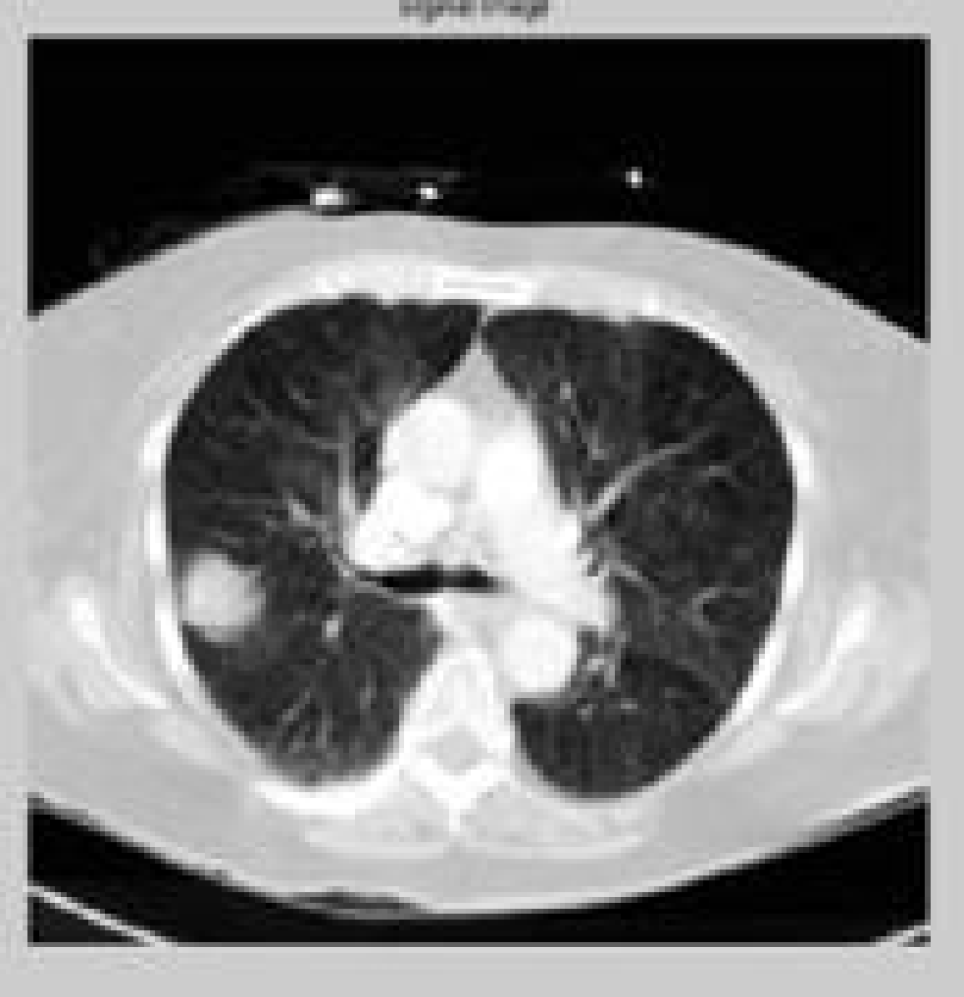
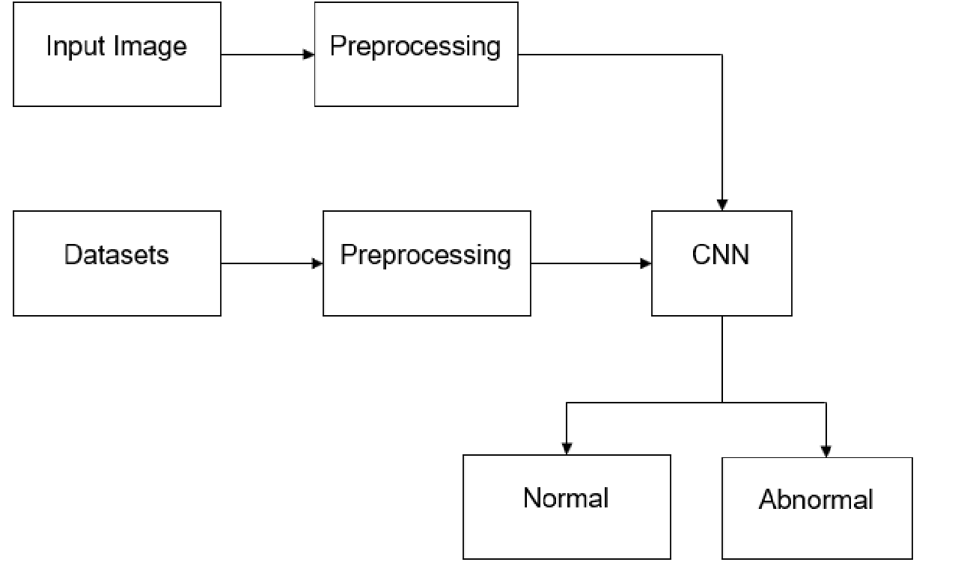
Model Training: CNN algorithm

Slide 9
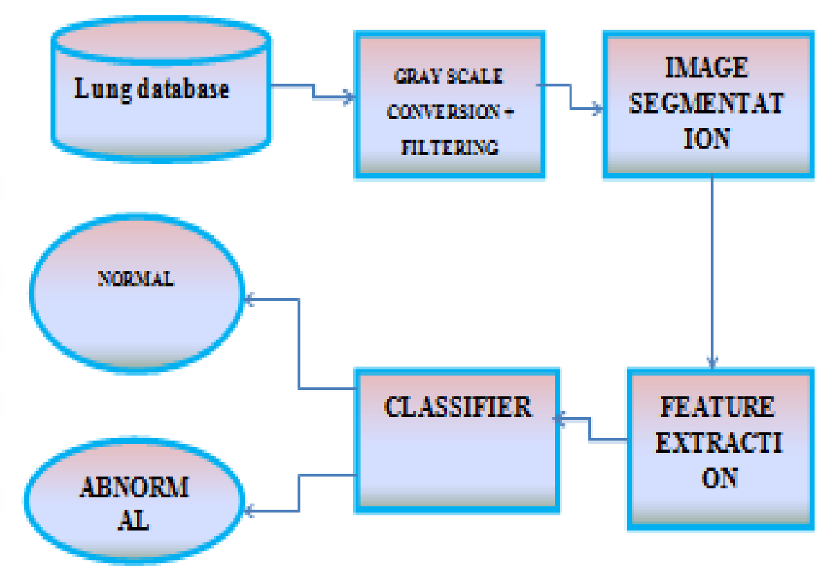
Block diagram:

Slide 10
Advantages and Disadvantages:
Advantages:
Early detection of cancer greatly increases the chances for successful treatment.
With the use of this treatment is often simpler and more likely to be effective.
The proposed systems are more efficient and give the better result.
Provides better image quality and accuracy.
Disadvantages:
The input image must have clarity to predict the correct output.
High computational cost.

Slide 11
Applications:
It is widely used in many medical areas for early detection of cancer .So the proper treatment will be provided to the patient.
It consists of few stages. The first stage starts with taking a collection of CT images (normal and abnormal) from the available database from IMBA home.

Slide 12
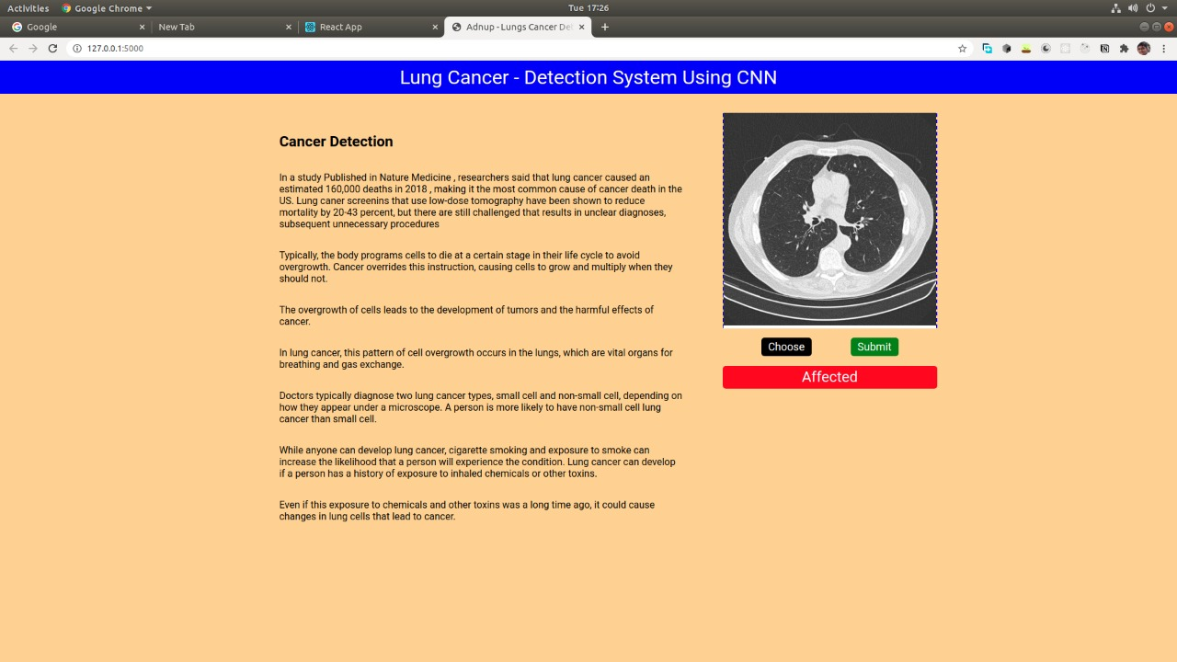
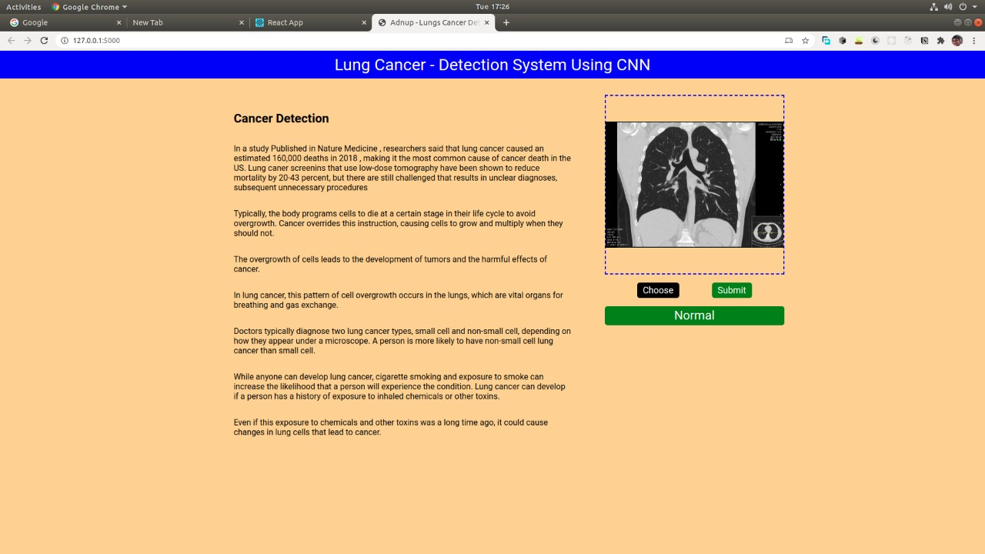
Flask: Using flask we deploy the model

Slide 13
RESULT:
We got an accuracy of 0.86 which is good measure for a Lung Cancer identification.
The Model predicts whether the Lung is affected by cancer or not with good efficiency.

Slide 14
THANK YOU

